Slide 1



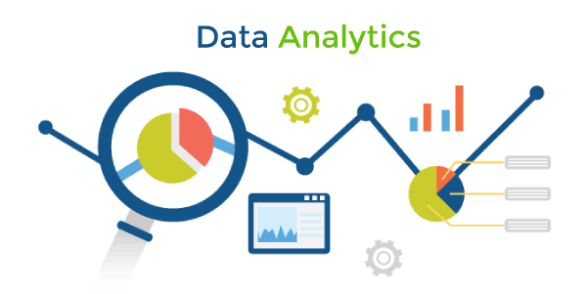


Machine learning and Data analytics using Python
Guido Van Rossum

Slide 2
Module-1: Introduction to Machine Learning and Python:
Introduction to Machine Learning: Definition and importance of machine learning, Types of machine learning: Supervised, unsupervised, and reinforcement learning, Applications of machine learning in various domains.
Python for Data Analysis: Introduction to Python programming, Python libraries for data analysis: NumPy, Pandas, Matplotlib, Data manipulation and visualization using Pandas and Matplotlib.
Data Preprocessing: Data cleaning and transformation, Handling missing values and outliers, Feature scaling and normalization.

Slide 3
Machine Learning (ML)
ML is an application of AI that provides Systems or Models the ability to automatically learn and improve from experience without being explicitly programmed and without human intervention .
Machine Learning (ML) is a subfield of artificial intelligence (AI) that focuses on the development of algorithms and models that enable computers to learn and make predictions or decisions without being explicitly programmed for a specific task.
The primary aim of machine learning is to allow the computers learn automatically without human intervention or assistance and adjust actions accordingly.
Examples:
The Self-Driving Car
The Spam Filter
Music Recommender
Personal Assistance (Alexa)

Slide 4
Definition:
According to Tom Mitchell Machine Learning is the study of algorithms that improve their performance P at some task T with experience E. A well-defined learning task for a system is given by <P, T, E>.
AI, ML and DL:
AI: Creation of Intelligent Machines that think and act like a Humans Ex: Robots.
ML: Approach for Computers to learn without being explicitly programmed.
DL: Training of Machines to think like a human brains- Application of Artificial Neural Networks.

Slide 5
Traditional Programming V/S Machine Learning :
Traditional Programming:
In traditional programming, a computer engineer writes a series of directions that instruct a computer how to transform input data into a desired output. Instructions are mostly based on an IF-THEN structure: when certain conditions are met, the program executes a specific action.
Machine Learning:
Machine learning, on the other hand, is an automated process that enables machines to solve problems with little or no human input, and take actions based on past observations.

Slide 6
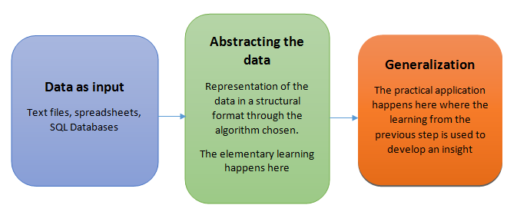
Basic machine learning process:
The basic machine learning process can be divided into three parts.
Data Input: Past data or information is utilized as a basis for future decision-making
Abstraction (Creating a Internal representation of the data by capturing the essential information): The input data is represented in a broader way through the underlying algorithm
Generalization: Generalization refers to the ability of a model to perform well on new, unseen data that it hasn't been trained on.

Slide 7
Data Input:
This is the foundation of any machine learning task. Data can come from various sources like sensors, databases, logs, text files, and images.
The data should be relevant to the problem you're trying to solve, diverse enough to capture different scenarios, and accurate to avoid misleading the model.
Often, data needs pre-processing before feeding it into the model. This can involve cleaning, formatting, feature engineering (creating new features), and handling missing values.
Note:
The quality and quantity of the input data significantly impact the effectiveness of the machine learning model.

Slide 8
Abstraction: (Training the model):
During the machine learning process, knowledge is fed in the form of input data.
This is where the magic happens! The chosen machine learning algorithm analyzes the processed data, searching for patterns, relationships, and underlying structures.
The algorithm creates an internal representation of the data, capturing the essential information it needs for prediction. This abstraction can be mathematical equations, rules, decision trees, or even complex neural networks.
Think of it like summarizing a book into key themes and plot points; the abstraction captures the essence or core of the information without needing all the details.
The choice of the model used to solve a specific learning problem is a human task. The decision related to the choice of model is taken based on multiple aspects, some of which are listed below:
The type of problem to be solved: Whether the problem is related to prediction or forecast , analysis of trend, understanding the different segments or groups of objects, etc.
Nature of the input data: How exhaustive the input data is, whether the data has no values for many fields, the data types etc.
Domain of the problem: If the problem is in a business critical domain with a high rate of data input and need for immediate inference, e.g. fraud detection problem in banking domain.

Slide 9
Generalization:
Generalization refers to the ability of a model to perform well on new, unseen data that it hasn't been trained on. The ultimate goal of a machine learning model is not just to memorize the training data but to learn underlying patterns and relationships that can be applied to new, unseen data in a meaningful way.
The first part of machine learning process is abstraction i.e. abstract the knowledge which comes as input data in the form of a model. However, this abstraction process, or more popularly training the model, is just one part of machine learning. The other key part is to tune up the abstracted knowledge to a form which can be used to take future decisions. This is achieved as a part of generalization.
This is where the model's power lies. Based on the abstracted representation, the model goes beyond the specific data it was trained on and learns to make general predictions for unseen data.
This part is quite difficult to achieve. This is because the model is trained based on a finite set of data, which may possess a limited set of characteristics. But when we want to apply the model to take decision on a set of unknown data, usually termed as test data.

Slide 10
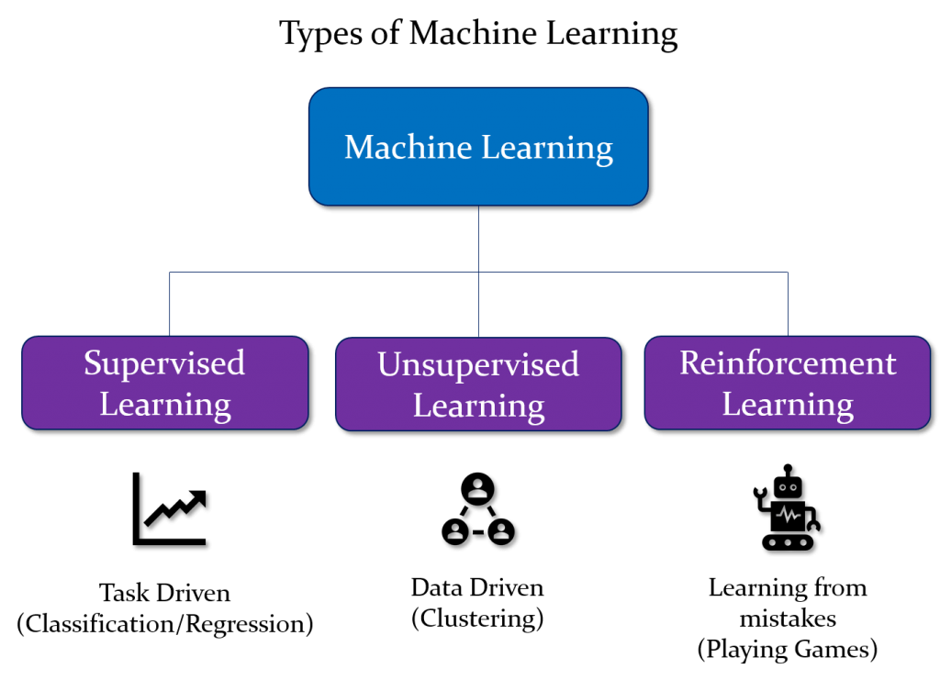

Slide 11
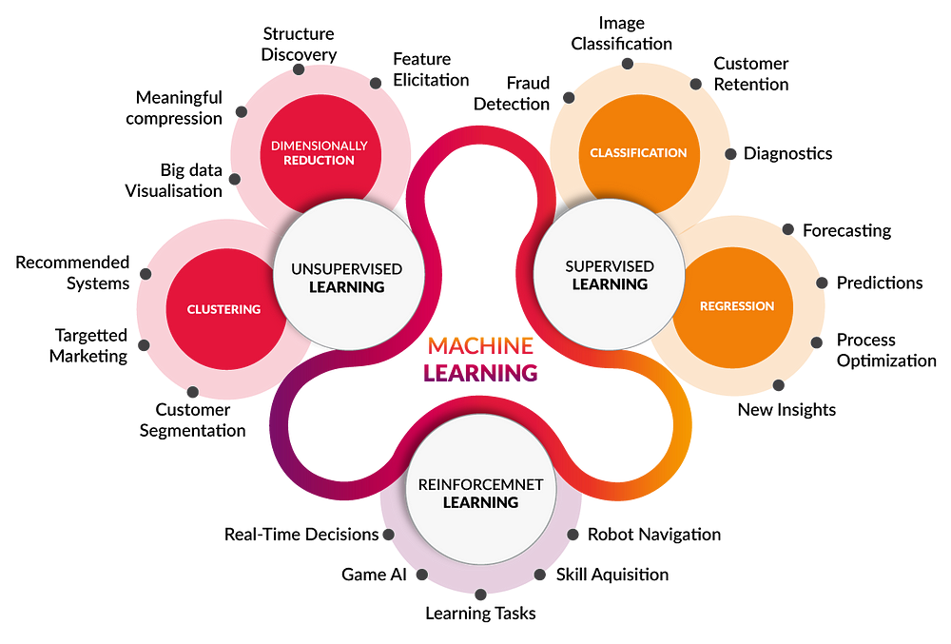

Slide 12
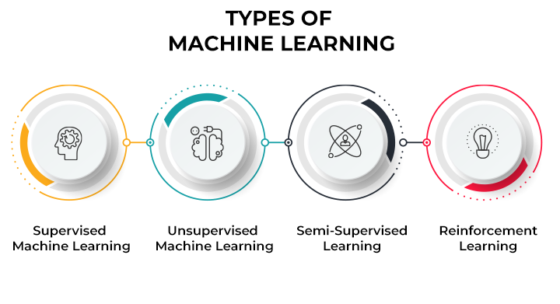

Slide 13
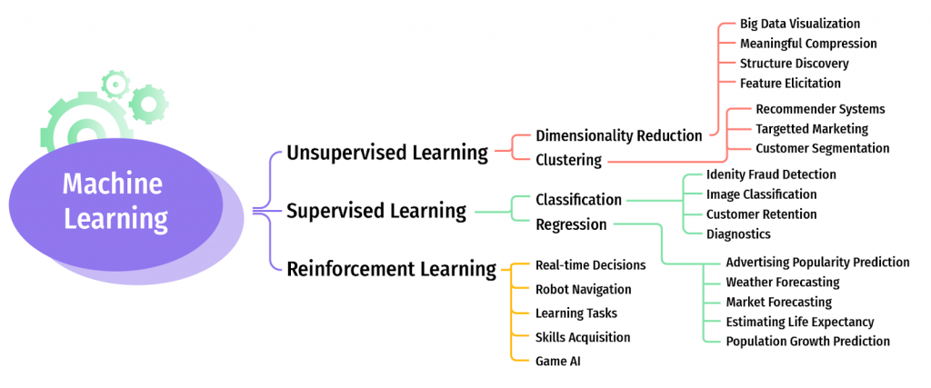
ML and It’s Application

Slide 14
Supervised learning:
Supervised learning is the types of machine learning in which machines are trained using well "labelled" training data, and on basis of that data, machines predict the output. The labelled data means some input data is already tagged or labelled with the correct output.
In supervised learning, the training data provided to the machines work as the supervisor that teaches the machines to predict the output correctly. It applies the same concept as a student learns in the supervision of the teacher. Supervised learning is a process of providing input data as well as correct output data to the machine learning model. The aim of a supervised learning algorithm is to find a mapping function to map the input variable(x) with the output variable(y).
So, the goal of supervised learning is to learn a mapping from inputs to outputs, so that the model can make accurate predictions on new, unseen data.
Note:
In supervised learning, models are trained using labelled dataset, where the model learns about each type of data. Once the training process is completed, the model is tested on the basis of test data (a subset of the training set), and then it predicts the output.
https://www.youtube.com/watch?v=olFxW7kdtP8

Slide 15
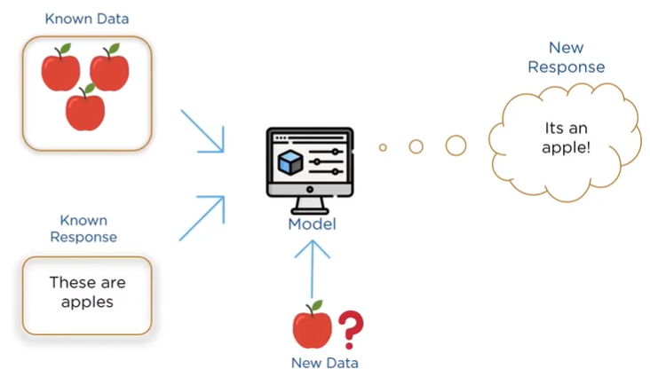

Slide 16
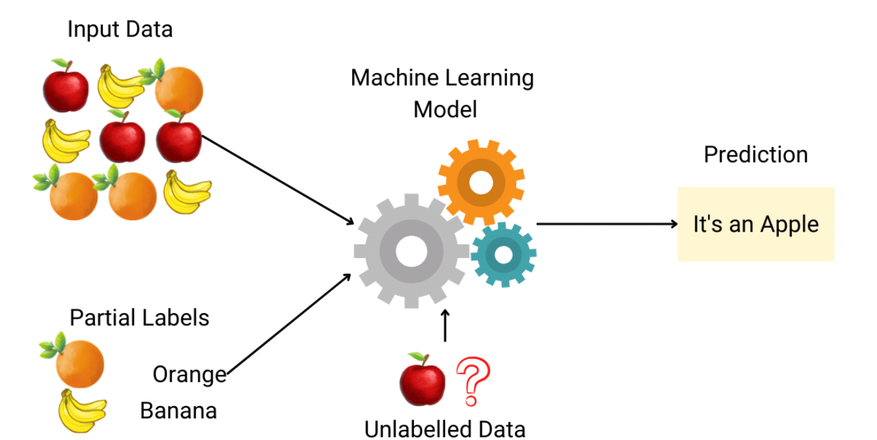

Slide 17
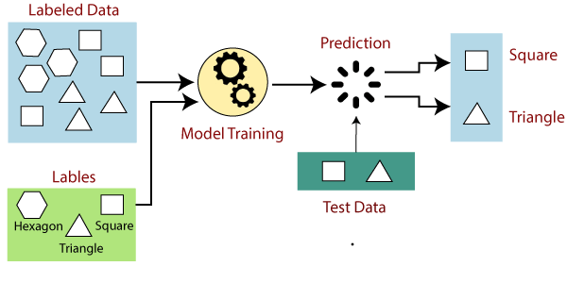

Slide 18
Explanation:
Suppose we have a dataset of different types of shapes which includes square, rectangle, triangle, and Polygon. Now the first step is that we need to train the model for each shape.
If the given shape has four sides, and all the sides are equal, then it will be labelled as a Square.
If the given shape has three sides, then it will be labelled as a triangle.
If the given shape has six equal sides then it will be labelled as hexagon.
Now, after training, we test our model using the test set, and the task of the model is to identify the shape. The machine is already trained on all types of shapes, and when it finds a new shape, it classifies the shape on the bases of a number of sides, and predicts the output

Slide 19
Example-3: Predicting Housing Prices
Let's consider a common example of supervised learning: predicting housing prices based on various features.
Input Features:
Size of the house (in square feet)
Number of bedrooms
Number of bathrooms
Distance to the city center
Presence of nearby amenities (e.g., schools, parks)
Labels (Outputs):
Sale price of the house
Training Dataset:
A dataset containing historical examples of houses with features and their corresponding sale prices.
Model:
A supervised learning algorithm, such as linear regression, is chosen to learn the relationship between the input features and the sale prices.

Slide 20
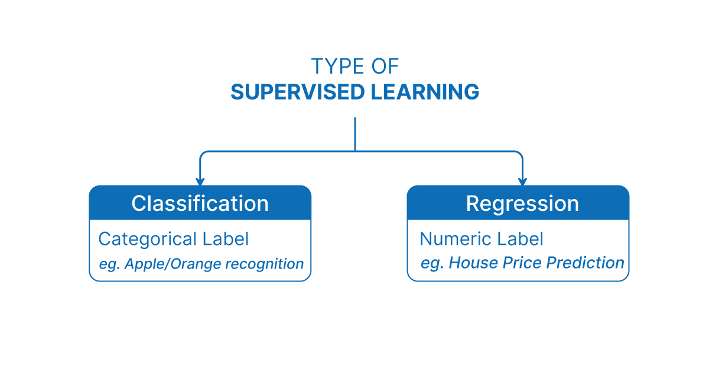

Slide 21
Classification:
Classification is a type of supervised machine learning task where the goal is to predict the category or class that a new instance or observation belongs to, on the basis of training data. The output variable in classification is discrete and represents different classes or labels.
In Classification, a program learns from the given dataset or observations and then classifies new observation into a number of classes or groups. Such as, Yes or No, 0 or 1, Spam or Not Spam, cat or dog, etc. Classes can be called as targets/labels or categories.
Unlike regression, the output variable of Classification is a category, not a value, such as "Green or Blue", "fruit or animal", etc. Since the Classification algorithm is a Supervised learning technique, hence it takes labeled input data, which means it contains input with the corresponding output. The best example of an ML classification algorithm is Email Spam Detector.
The main goal of the Classification algorithm is to identify the category of a given dataset, and these algorithms are mainly used to predict the output for the categorical data.

Slide 22
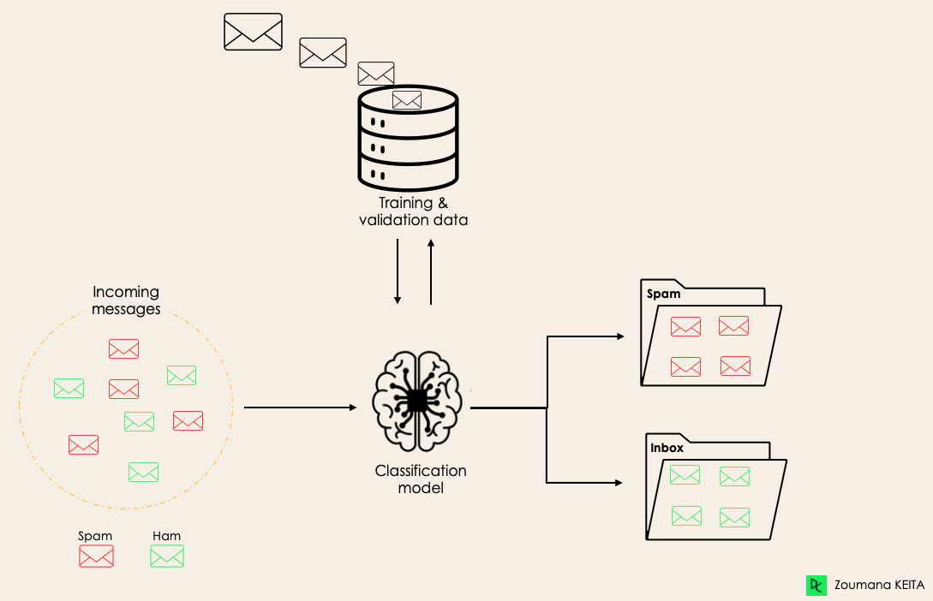
Spam Detection

Slide 23
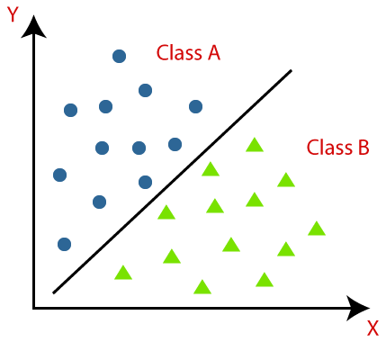
Example-2:
Classification algorithms can be better understood using the below diagram. In the below diagram, there are two classes, class A and Class B. These classes have features that are similar to each other and dissimilar to other classes.
The algorithm which implements the classification on a dataset is known as a classifier.
There are two types of Classifications:
Binary Classification
Multi-class Classifier

Slide 24
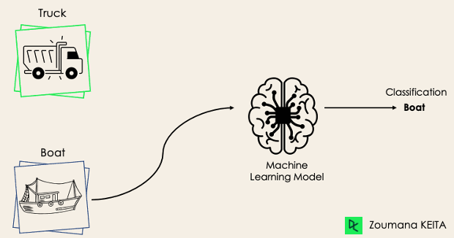
Binary Classification
In a binary classification task, the goal is to classify the input data into two mutually exclusive categories. The training data in such a situation is labeled in a binary format: true and false; positive and negative; O and 1; spam and not spam, male or female etc. depending on the problem being tackled.
For instance, we might want to detect whether a given image is a truck or a boat.
In Binary classification task, “Mutually Exclusive" means that the two categories or classes into which the input data is classified are distinct and cannot occur simultaneously for a single instance of input data.
An email cannot be both "spam" and "not spam" at the same time.
Note: If the classification problem has only two possible outcomes, then it is called as Binary Classifier.

Slide 25
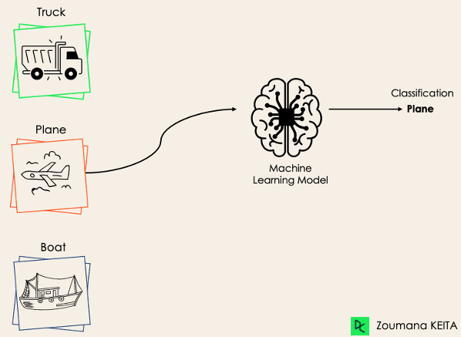
If a classification problem has more than two outcomes, then it is called as Multi-class Classifier.
Example: Classifications of types of crops, Classification of types of music.
Multi-Class Classification:
The multi-class classification, on the other hand, has at least two mutually exclusive class labels, where the goal is to predict to which class a given input example belongs to. In the following case, the model correctly classified the image to be a plane.

Slide 26
Regression :
Regression is a type of supervised machine learning task where the goal is to predict a continuous numerical value or outcome based on input features.
Regression is a type of supervised machine learning where algorithms learn from the data to predict continuous values such as sales, salary, weight, or temperature.
What mean by continuous numerical value :
In machine learning, the term continuous values refers to numeric values that can take any value within a range, not just fixed or distinct values.
These are real numbers (decimals or integers) that can vary smoothly over a range, as opposed to categorical values, which are fixed labels or classes (like "Yes"/"No", or "Red"/"Green").

Slide 27
Note: In the context of regression in machine learning, a continuous numerical value refers to an outcome or target variable that can take on an infinite number of values within a specific range. In case of predicting a person's age, age is considered a continuous numerical value because it can theoretically take on any value within a certain range (for example, from 0 to 100+ years). There are no gaps or intervals between possible ages, and age can be expressed as a decimal or fraction if necessary (e.g., 25.5 years).
It is a variable that can have any real number value, and there are no distinct categories or classes. The term "continuous" implies that the variable can vary over a continuous range, and there are no gaps or interruptions in the possible values it can take. In contrast, in a classification task, the target variable would be a discrete set of categories or classes.
Note:
Here, “discrete set of categories or classes" refers to a set of distinct and separate values that a variable can take

Slide 28
🔁 Regression Contrast with Classification:
In classification, the outputs are discrete categories, like:
"Pass" or "Fail"
"Spam" or "Not Spam"
"Dog", "Cat", or "Bird"
Whereas in regression, the goal is to predict a number, like:
88.4 marks
₹56,789.25 income

Slide 29
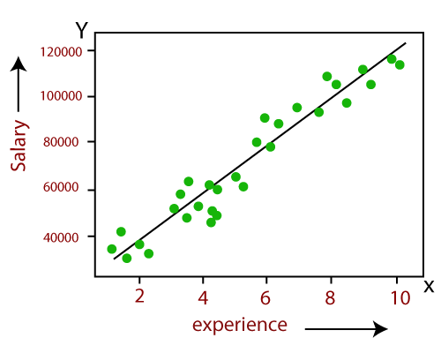
Example:
Linear Regression:
Predicting the salary of an employee on the basis of the year of experience.

Slide 30
Example:
Predicting age of a person: Given certain features or attributes of a person, such as height, weight, gender, and other relevant factors, the task is to predict the person's age in years.
Predicting the price of houses based on their features:
In real estate markets, house prices can vary continuously based on factors such as location, size, amenities, market conditions, and other features. The House prices can range from a few thousand dollars for smaller properties in certain areas to millions of dollars for luxury properties in prime locations.

Slide 31
Important to Note:
Let us consider two examples, say ‘predicting whether a tumour is malignant or benign’ and ‘price prediction in the domain of real estate? Are these two problems same in nature?
The answer is ‘no’ It is true that both of them are problems related to prediction. However, for tumour prediction, we are trying to predict which category or class, i.e. ‘malignant’ or ‘benign’, an unknown input data related to tumour belongs to.
In the other case, that is, for price prediction, we are trying to predict an absolute value and not a class. When we are trying to predict a categorical or nominal variable, the problem is known as a classification problem. A classification problem is one where the output variable is a category such as ‘red’ or ‘blue’ or ‘malignant tumour’ or ‘benign tumour’ etc. Whereas when we are trying to predict a numerical variable such as ‘price’, ‘weight’, etc. the problem falls under the category of regression.

Slide 32
Regression analysis :
Regression analysis is a statistical method to model the relationship between a dependent (target) and independent (predictor) variables with one or more independent variables. More specifically, Regression analysis helps us to understand how the value of the dependent variable is changing corresponding to an independent variable when other independent variables are held fixed. It predicts continuous/real values such as temperature, age, salary, price etc. Regression is a supervised learning which helps in finding the correlation between variables and enables us to predict the continuous output variable based on the one or more predictor variables.
It is mainly used for prediction, forecasting, time series modeling, and determining the causal-effect relationship between variables.

Slide 33
Unsupervised Learning:
Unsupervised Machine learning is a type of machine learning where the algorithm is trained on unlabeled data, and the objective is to find patterns, relationships, or structures within the data without explicit guidance or labeled outcomes. i.e Unsupervised learning is a method we use to group data when no labels are present.
As the name suggests, unsupervised learning is a machine learning technique in which models are not supervised using training dataset. Instead, models itself find the hidden patterns and insights from the given data. It can be compared to learning which takes place in the human brain while learning new things.
It can be defined as: “Unsupervised learning is a type of machine learning in which models are trained using unlabeled dataset and are allowed to act on that data without any supervision.”
Unsupervised learning cannot be directly applied to a regression or classification problem because unlike supervised learning, we have the input data but no corresponding output data.
Example:
Suppose the unsupervised learning algorithm is given an input dataset containing images of different types of cats and dogs. The algorithm is never trained upon the given dataset, which means it does not have any idea about the features of the dataset. The task of the unsupervised learning algorithm is to identify the image features on their own. Unsupervised learning algorithm will perform this task by clustering the image dataset into the groups according to similarities between images.

Slide 34
Why use Unsupervised Learning?
Unsupervised learning is helpful for finding useful insights from the data.
Unsupervised learning is much similar as a human learns to think by their own experiences, which makes it closer to the real AI.
Unsupervised learning works on unlabeled and uncategorized data which make unsupervised learning more important.
In real-world, we do not always have input data with the corresponding output so to solve such cases, we need unsupervised learning.
Semi-supervised Learning: Unsupervised ML techniques can also be combined with supervised ML in semi-supervised learning approaches. In this paradigm, a small amount of labeled data is augmented with a larger amount of unlabeled data to improve the performance of supervised models.
Note:
Unsupervised machine learning (ML) works differently from supervised ML because it doesn't rely on labeled data to learn patterns or make predictions. Instead, unsupervised ML algorithms focus on finding hidden structure or patterns within the data without explicit guidance from predefined labels.

Slide 35
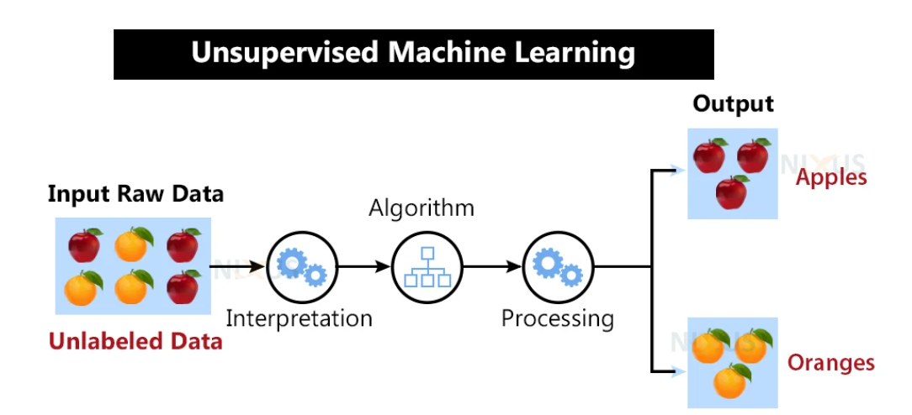

Slide 36
Here, we have taken an unlabeled input data, which means it is not categorized and corresponding outputs are also not given. Now, this unlabeled input data is fed to the machine learning model in order to train it. Firstly, it will interpret the raw data to find the hidden patterns from the data and then will apply suitable algorithms such as k-means clustering, Decision tree, etc. Once it applies the suitable algorithm, the algorithm divides the data objects into groups according to the similarities and dissimilarities between the objects.
Working of Unsupervised learning models:
We feed the model data with no categories or outputs for training
Model interprets raw data to identify hidden patterns
Depending on data, we use suitable algorithms
Algorithm groups data

Slide 37
Disadvantages of Unsupervised Learning:
1. Unsupervised learning is fundamentally more difficult than supervised learning since it lacks comparable results.
2. The outcome of an unsupervised learning approach may be less accurate since the input data does not have labels and algorithms do not know the precise output in advance.
3. We need humans to validate the results of unsupervised learning models which convolutes the process.
4. The operations involved require a high level of computational power and also take up a lot of time.
Alternative to Unsupervised Learning:
Semi-supervised learning may be a viable alternative to unsupervised learning. It is a combination or even a min-and-match of both unsupervised and supervised learning methods. The primary benefit of this sort of training would be that it lowers errors.
For example, it will only cluster the unlabeled data that fits the clustering criteria, and it will categorize the output automatically once it has labels. This uses less computer power and takes less time.

Slide 38
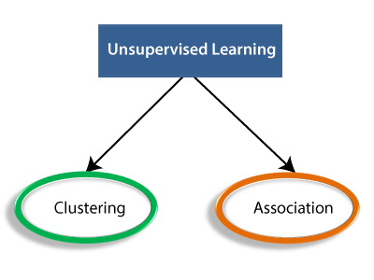
Types of Unsupervised Learning:
1. Clustering
2. Association rules
3. Dimensionality reduction.

Slide 39
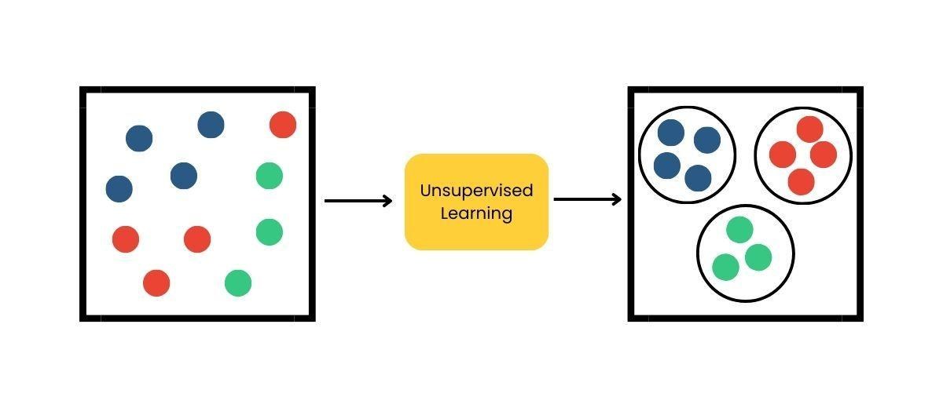
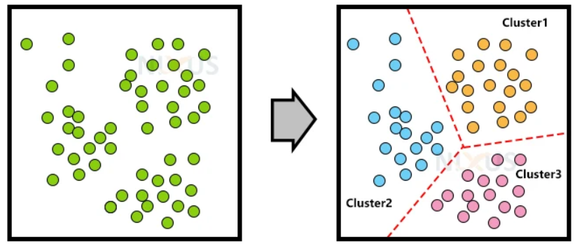
Clustering:
Clustering methods involve grouping untagged data based on their similarities and differences. When two instances appear in different groups, we can infer they have dissimilar properties.
Clustering is a type of unsupervised learning, meaning that we do not need labeled data for clustering algorithms; this is one of the biggest advantages of clustering over other supervised learning like Classification.
Clustering is the process of arranging a group of objects in such a manner that the objects in the same group (which is referred to as a cluster) are more similar to each other than to the objects in any other group.
OR

Slide 40
Application of Clustering:
1. Customer Segmentation:
Objective: Grouping customers based on similarities in purchasing behavior, demographics, or preferences.
Application: Targeted marketing, personalized recommendations, and tailored customer experiences.
2. Document Clustering:
Objective: Grouping similar documents based on content, topic, or language.
Application: Document categorization, information retrieval, and organizing large document repositories.
3. Anomaly Detection:
Objective: Identifying unusual patterns or outliers in a dataset.
Application: Fraud detection in financial transactions, network intrusion detection, and fault detection in industrial systems.
4. Retail Market Basket Analysis:
Objective: Identifying associations and patterns in the purchasing behavior of customers.
Application: Recommender systems, optimizing product placements, and understanding customer buying habits.
5. E-commerce Product Bundling:
Objective: Grouping products that are often purchased together.
Application: Creating product bundles, improving cross-selling strategies, and enhancing the user shopping experience.

Slide 41
Association Rule:
An association rule is an unsupervised learning method which is used for finding the relationships between variables in the large database. It determines the set of items that occurs together in the dataset. Association rule makes marketing strategy more effective. Such as people who buy X item (suppose a bread) are also tend to purchase Y (Butter/Jam) item. A typical example of Association rule is Market Basket Analysis(MBA).
We typically see association rule mining used for market basket analysis: this is a data mining technique retailers use to gain a better understanding of customer purchasing patterns based on the relationships between various products.
So Association is the process of discovering interesting relationships, associations, or patterns within a dataset. This type of analysis is often applied to transactional data, where the goal is to identify associations between items or events that frequently co-occur. Association rules are used to express these relationships, and they help reveal hidden connections in the data.

Slide 42
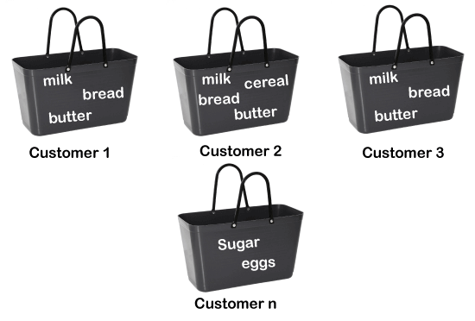
For example, if a customer buys bread, he most likely can also buy butter, eggs, or milk, so these products are stored within a shelf or mostly nearby.

Slide 43
3. Dimensionality Reduction:
Dimensionality reduction is a technique used in unsupervised machine learning to reduce the number of input features or variables in a dataset while preserving as much of its essential information. In other words, it is a process of transforming high-dimensional data into a lower-dimensional space that still preserves the essence of the original data. The primary goal is to overcome the curse of dimensionality, improve computational efficiency, and sometimes enhance the interpretability of the data. Two common methods for dimensionality reduction are Principal Component Analysis (PCA) and t-Distributed Stochastic Neighbor Embedding (t-SNE).
In machine learning, high-dimensional data refers to data with a large number of features or variables. The curse of dimensionality is a common problem in machine learning, where the performance of the model deteriorates or drops as the number of features increases. This is because the complexity of the model increases with the number of features, and it becomes more difficult to find a good solution. In addition, high-dimensional data can also lead to overfitting, where the model fits the training data too closely and does not generalize well to new data.
It’s helpful to reduce the dimensionality of a dataset during EDA (Exploratory Data Analysis) to help visualize data: this is because visualizing data in more than three dimensions is difficult. From a data processing perspective, reducing the dimensionality of the data simplifies the modeling problem.
When more input features are being fed into the model, the model must learn a more complex approximation function. This phenomenon can be summed up by a saying called the “curse of dimensionality.”

Slide 44
Dimensionality reduction can help to mitigate these problems by reducing the complexity of the model and improving its generalization performance. There are two main approaches to dimensionality reduction: feature selection and feature extraction.
Feature Engineering:
Feature Selection:
Feature selection involves selecting a subset of the original features that are most relevant to the problem at hand. The goal is to reduce the dimensionality of the dataset while retaining the most important features. There are several methods for feature selection, including filter methods, wrapper methods, and embedded methods. Filter methods rank the features based on their relevance to the target variable, wrapper methods use the model performance as the criteria for selecting features, and embedded methods combine feature selection with the model training process.
2. Feature Extraction:
Feature extraction involves creating new features by combining or transforming the original features. The goal is to create a set of features that captures the essence of the original data in a lower-dimensional space. There are several methods for feature extraction, including principal component analysis (PCA), linear discriminant analysis (LDA), and t-distributed stochastic neighbor embedding (t-SNE). PCA is a popular technique that projects the original features onto a lower-dimensional space while preserving as much of the variance as possible.

Slide 45
Reinforcement Learning:
Reinforcement Learning (RL) is a type of machine learning paradigm in which an agent learns to make decisions by interacting with an environment. The agent takes actions in the environment, and in return, it receives feedback in the form of rewards or punishments.
Reinforcement Learning is a feedback-based Machine learning technique in which an agent learns to behave in an environment by performing the actions and seeing the results of actions. For each good action, the agent gets positive feedback, and for each bad action, the agent gets negative feedback or penalty. In Reinforcement Learning, the agent learns automatically using feedbacks without any labeled data, unlike supervised learning Since there is no labeled data, so the agent is bound to learn by its experience only. RL solves a specific type of problem where decision making is sequential, and the goal is long-term, such as game-playing, robotics, etc. The agent interacts with the environment and explores it by itself. The primary goal of an agent in reinforcement learning is to improve the performance by getting the maximum positive rewards.
The agent learns with the process of hit and trial, and based on the experience, it learns to perform the task in a better way. Hence, we can say that "Reinforcement learning is a type of machine learning method where an intelligent agent (computer program) interacts with the environment and learns to act within that." How a Robotic dog learns the movement of his arms is an example of Reinforcement learning.
It is a core part of Artificial Intelligence, and all AI agent works on the concept of reinforcement learning. Here we do not need to pre-program the agent, as it learns from its own experience without any human intervention

Slide 46
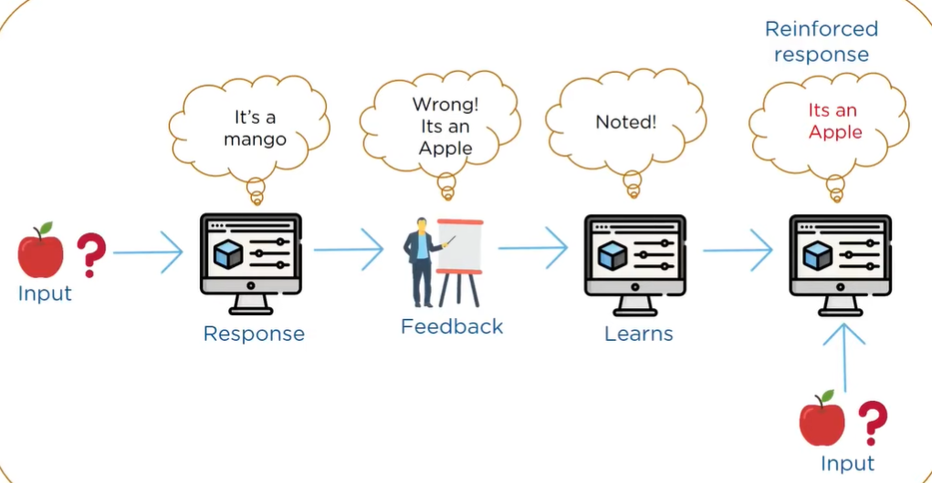
Example

Slide 47
MACHINE LEARNING ACTIVITIES:
The first step in machine learning activity starts with data. In case of supervised learning, it is the labelled training data set followed by test data which is not labelled. In case of unsupervised learning, there is no question of labelled data but the task is to find patterns in the input data.
A thorough review and exploration of the data is needed to understand the type of the data, the quality of the data and relationship between the different data elements. Based on that, multiple pre-processing activities may need to be done on the input data before we can go ahead with core machine learning activities. Following are the typical preparation activities done once the input data comes into the machine learning system:
Understand the type of data in the given input data set (For example Numerical Data).
Explore the data to understand the nature and quality.
Explore the relationships amongst the data elements, e.g. inter-feature relationship.
Find potential issues in data. (you might find missing values, outliers, duplicate entries, or data entry errors)
Do the necessary remediation, e.g. impute missing data values, etc., if needed. Once issues are identified, you take steps to address them.
Apply the following pre-processing steps, as necessary.
1. Dimensionality Reduction
2. Feature sub-set selection
Once the data is prepared for modelling, then the learning tasks start off.

Slide 48
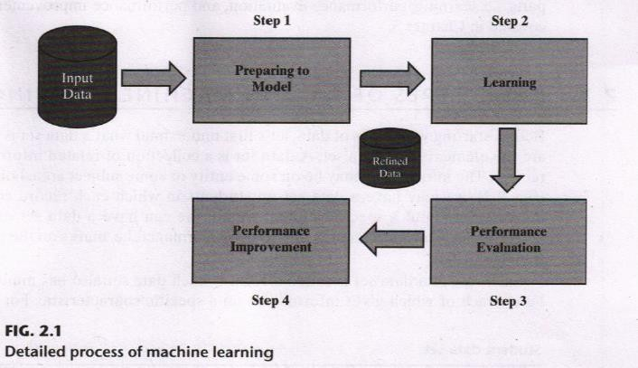
Once the data is prepared for modelling, then the learning tasks start off. As a part of it, do the following activities:
“ The input data is first divided into parts — the training data and the test data (called holdout). This step is applicable for supervised learning only.
Consider different models or learning algorithms for selection. “Train the model based on the training data for supervised learning problem and apply to unknown data. Directly apply the chosen unsupervised model on the input data for unsupervised learning problem.
After the model is selected, trained (for supervised learning), and applied on input data, the performance of the model is evaluated. Based on options available, specific actions can be taken to improve the performance of the model, if possible.

Slide 49



Slide 50
What is Python:
Python is an general purpose, Object-oriented, High-level, Dynamically Typed, Compiled and Interpreted programming language known for its simplicity and readability.
Common Uses of Python:
Web Development: Using frameworks like Django and Flask.
Data Analysis and Visualization: With libraries like Pandas, Matplotlib, and Seaborn.
Artificial Intelligence and Machine Learning: Leveraging tools like TensorFlow, PyTorch, and Scikit-learn.
Automation/Scripting: Automating repetitive tasks using Python scripts.
Game Development: Using libraries like Pygame.
Scientific Computing: Libraries like SciPy and SymPy are used for simulations and computations.
Software Development: For prototyping and backend development.

Slide 51
Python Tokens:
In Python, tokens are the smallest units of the program that have a meaningful role. Python breaks every program into these tokens during the lexical analysis phase.
There are 5 types of Python tokens:
Keywords
Identifiers
Literals
String Literals
Numeric Literals
Boolean Literals
Special Literal (None)
Collection Literals
Operators
Punctuators

Slide 52
Interpretation in Python
The bytecode produced by the compilation step is executed by the Python Virtual Machine (PVM). The PVM interprets the bytecode line by line and executes it. This is what gives Python its "interpreted" behavior.
Key Points
Python is not a purely compiled language like C or C++, where code is compiled into machine code before execution.
Python is not a purely interpreted language like early versions of BASIC, which execute source code directly without compiling it.
Instead, Python uses a hybrid model: it compiles source code to bytecode (a form of intermediate code), which is then interpreted.

Slide 53
How Python is Compiled and Interpreted:
Python is often described as both a compiled and an interpreted language, depending on how you look at its execution process.
Compilation in Python:
When you run a Python program, it first goes through a compilation step.
The Python interpreter compiles the source code (.py file) into bytecode (a lower-level, platform-independent representation). This bytecode is stored in .pyc files (in the __pycache__ directory).
Note:
This compilation step is implicit and happens behind the scenes.
The bytecode is not directly executed by your machine; it is executed by the Python interpreter.

Slide 54
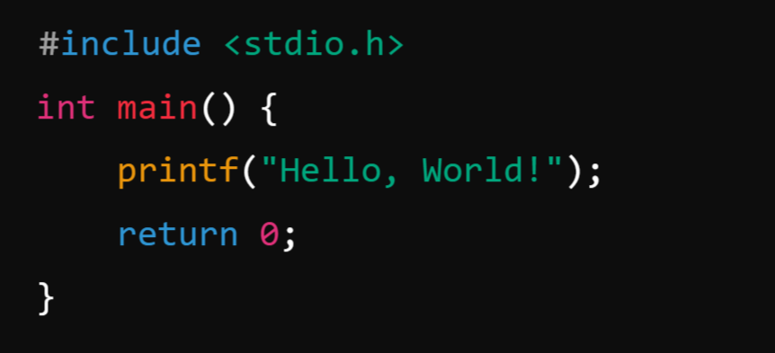
What is Compiler?
A compiler is a program that translates the entire source code of a programming language into machine code or intermediate code before execution. The compiled code is then executed directly by the computer's processor.
Example: C Language
Process: A C compiler (like GCC) compiles the code into a machine-readable .exe file, which can then be executed.

Slide 55
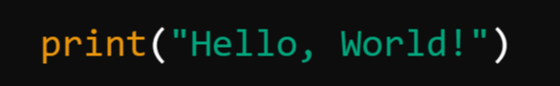
What is Interpreter?
An interpreter is a program that executes code line by line, translating it directly into machine code as it runs.
Example: Python:
Process: The Python interpreter reads the script line by line and executes it immediately.

Slide 56
📘 Definition: Python for Data Analysis
Python for Data Analysis refers to the use of the Python programming language to explore, clean, transform, visualize, and model data in order to gain insights and make data-driven decisions.
It combines programming with data manipulation, statistical analysis, and visualization techniques using powerful libraries like:
Pandas – for data manipulation and analysis
NumPy – for numerical operations
Matplotlib / Seaborn – for data visualization
Scikit-learn – for machine learning and predictive modeling
Jupyter Notebook – for interactive coding and exploration

Slide 57
🧠 Example Use Cases:
Analyzing sales trends from Excel/CSV files
Cleaning messy datasets (removing nulls, converting data types)
Creating dashboards and graphs for presentations
Building machine learning models to predict outcomes

Slide 58


Slide 59
🐼 Pandas in Python for Data Analysis?
Pandas is a powerful and popular open-source Python library used for data manipulation, analysis, and cleaning. It provides easy-to-use data structures and functions to work with structured (tabular) data efficiently.
🧠 Why Pandas?
It simplifies data analysis tasks.
Makes large data easy to understand and manipulate.
Built on top of NumPy, so it's very fast.

Slide 60


Slide 61
NumPy : TheNumPy NumPy (Numerical Python) is a powerful library in Python used for numerical computing. It provides support for large, multi-dimensional arrays and matrices, along with a collection of mathematical functions to operate on these arrays efficiently.
Why Use NumPy?
Faster than Python lists: NumPy arrays are more efficient than Python lists due to optimized memory and vectorized operations.
Supports Multi-dimensional Arrays: Easily handles 1D, 2D, and ND arrays.
Rich Mathematical Functions: Offers functions like mean, median, standard deviation, linear algebra, etc.
Integration with Libraries: Used in Pandas, Matplotlib, Scikit-Learn, TensorFlow, etc.

Slide 62
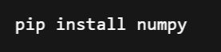
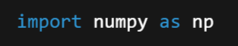
Installing and Importing NumPy
If you don’t have NumPy installed, install it using:
Then, import it in Python:

Slide 63
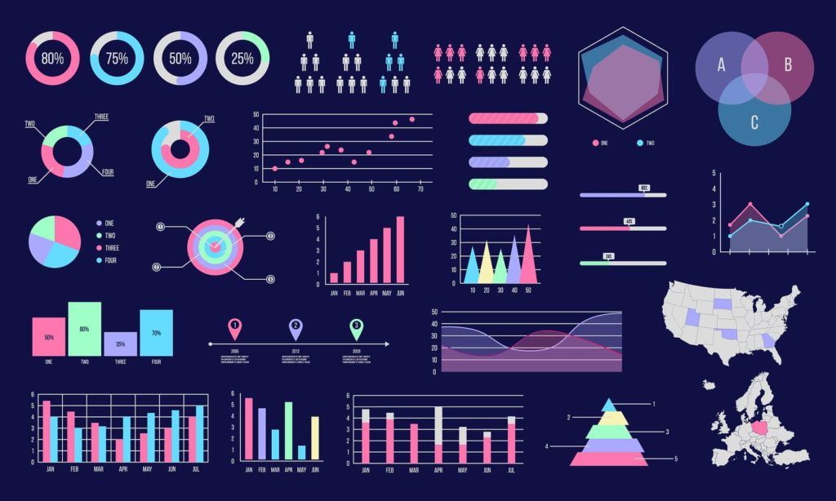
Numpy
Data
Matplotlib
Visualization

Slide 64
Data Visualization:
Data Visualization is the graphical representation of data and information. It helps in identifying trends, patterns, and insights in large datasets by using visual elements like charts, graphs, maps, and dashboards.
Why is Data Visualization Important?
Better Data Understanding – Makes complex data easier to comprehend.
Identifies Trends and Patterns – Helps spot correlations and anomalies quickly.
Improves Decision Making – Supports data-driven business strategies.
Enhances Communication – Presents data effectively for both technical and non-technical audiences.

Slide 65
Popular Data Visualization Tools
Tableau
Power BI
Matplotlib & Seaborn (Python)
D3.js (JavaScript)
Google Data Studio

Slide 66
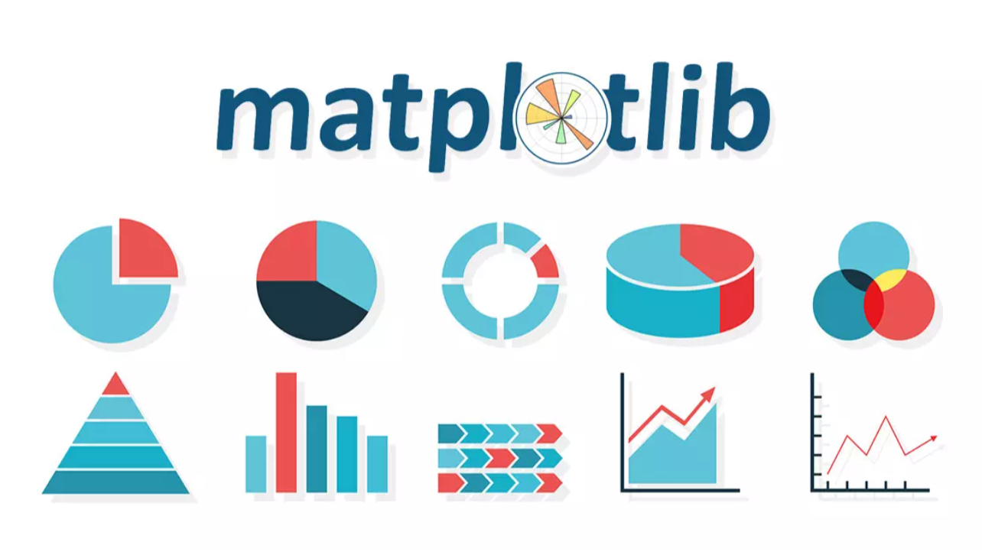

Slide 67
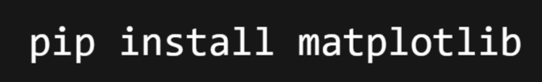
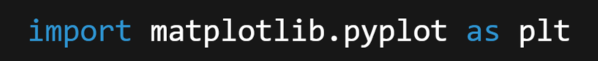
Matplotlib
Matplotlib is one of the most widely used Python libraries for data visualization. It provides tools to create static, animated, and interactive plots with a high degree of customization. It is particularly useful for plotting datasets in a variety of formats.
Installation: You can install Matplotlib using pip:
Importing Matplotlib:

Slide 68
Matplotlib Package:
Matplotlib provides functionalities to create various types of charts, graphs, and plots to visualize data effectively. It is particularly useful for scientific computing, machine learning, and statistical analysis.
Key Features of Matplotlib:
✅ Supports line plots, bar charts, histograms, scatter plots, pie charts, 3D plots, and more.
✅ Customizable plots with labels, legends, colors, styles, and annotations.
✅ Can save plots in PNG, JPG, PDF, SVG, etc.
✅ Works well with NumPy, Pandas, and SciPy.
✅ Allows interactive plotting using plt.ion().

Slide 69
Data manipulation and visualization using Pandas and Matplotlib.
🛠️ Data Manipulation with Pandas
Pandas helps us clean, reshape, analyze, and prepare data for visualization or further processing.
🔢 Basic Workflow:
Import Data
Clean Data
Transform & Filter
Aggregate/Summarize
Prepare for Visualization

Slide 70
Example:
📥 Input File: sales.csv
Date | Region | Sales | Profit
2023-01-01 | East | 3000 | 300
2023-01-02 | West | 7000 | 1000
2023-01-03 | South | 4500 | 500
2023-01-04 | East |  | 400
2023-01-05 | West | 8000 | 1200
2023-01-06 | South | 6000 | 700
2023-01-07 | North | 2000 | 300

Slide 71
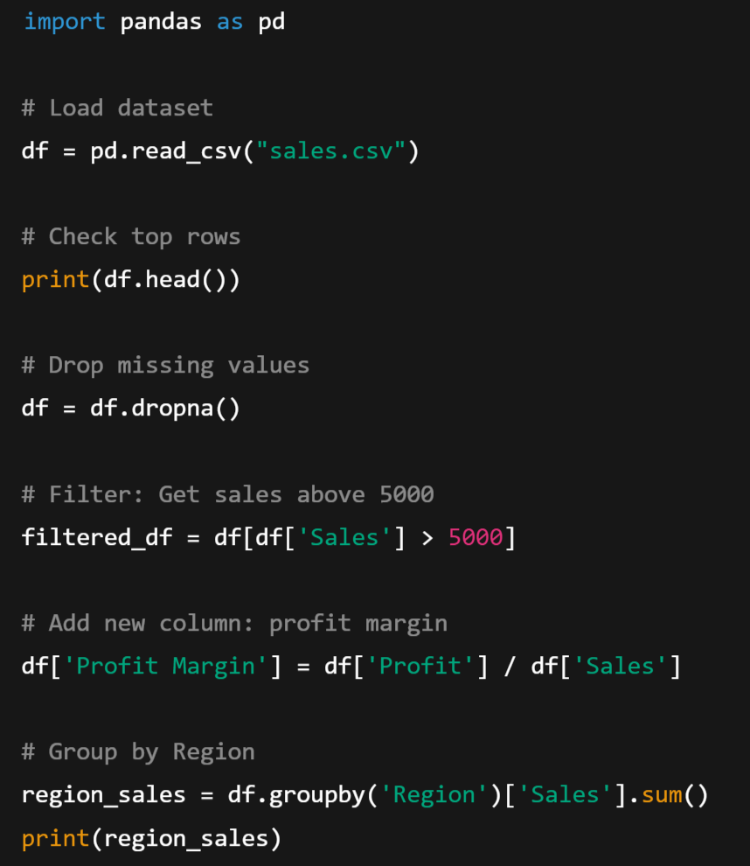
Output:
filtered_df (Sales > 5000):
df['Profit Margin’]:
Date | Region | Sales | Profit
2023-01-02 | West | 7000.0 | 1000
2023-01-05 | West | 8000.0 | 1200
2023-01-06 | South | 6000.0 | 700
Date | Region | Sales | Profit | Profit Margin
2023-01-01 | East | 3000.0 | 300 | 0.100000
2023-01-02 | West | 7000.0 | 1000 | 0.142857
2023-01-03 | South | 4500.0 | 500 | 0.111111
2023-01-05 | West | 8000.0 | 1200 | 0.150000
2023-01-06 | South | 6000.0 | 700 | 0.116667
2023-01-07 | North | 2000.0 | 300 | 0.150000

Slide 72
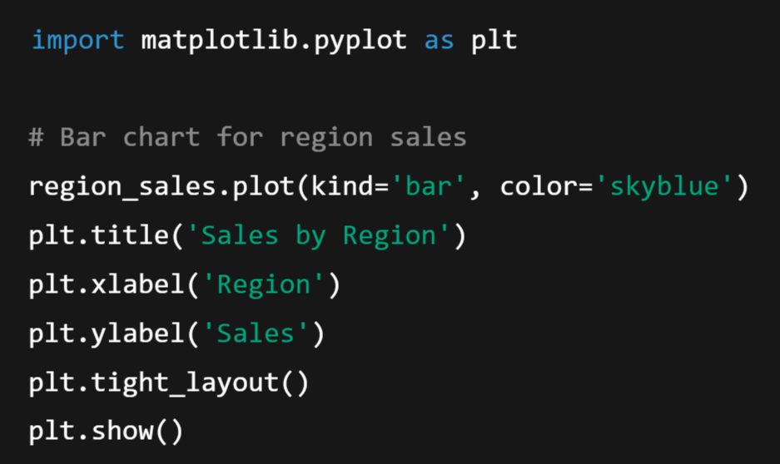
📊 Data Visualization with Matplotlib
Matplotlib is used to create visual representations of the data. Often used alongside Pandas for quick plotting.
📈 Basic Plotting Example:

Slide 73
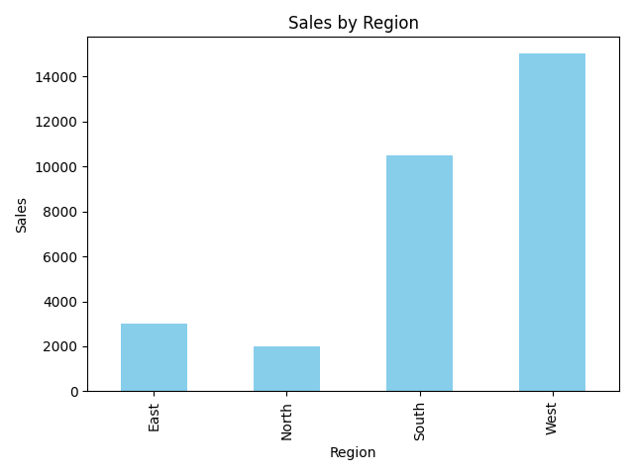
Output:

Slide 74

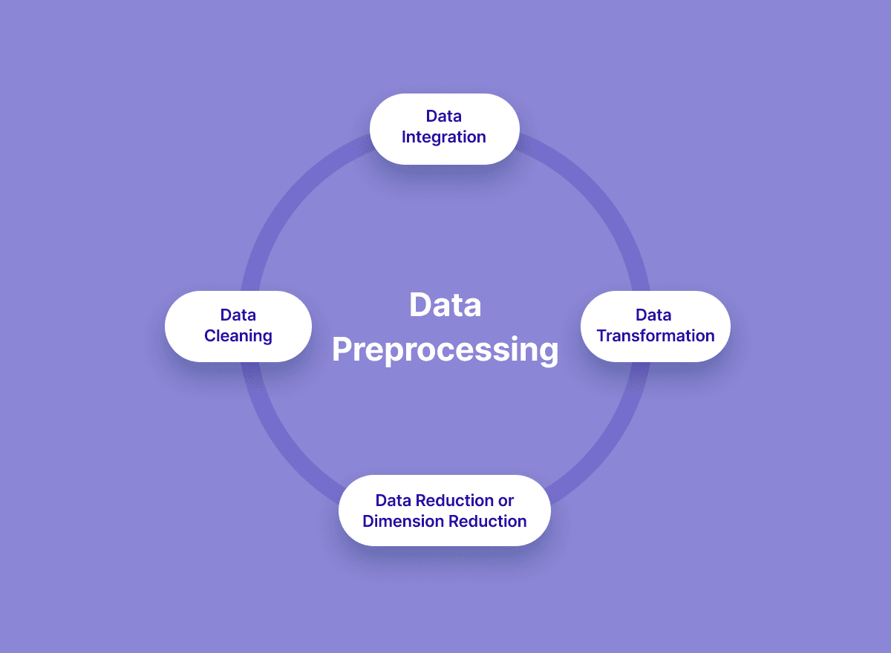
Data Preprocessing

Slide 75
✅ What is Data Wrangling?
Data Wrangling (also called Data Munging) is the process of cleaning, transforming, and structuring raw data into a usable format for analysis and machine learning.
💡 Why is it Important?
Real-world data is messy, inconsistent, and incomplete
Helps in improving data quality and model performance
Essential for insightful analysis and decision-making

Slide 76
🔍 Data Preprocessing in Data Analytics with Python:
✅ What is Data Preprocessing? A subset of data wrangling focused on preparing data for ML models.
Data Preprocessing is the process of cleaning, transforming, and preparing raw data before using it for analysis or machine learning models. Real-world data is often incomplete, inconsistent, and noisy, so preprocessing is crucial to improve accuracy and efficiency.
📌 Steps in Data Preprocessing:
1️⃣ Handling Missing Values
2️⃣ Handling Duplicate Data
3️⃣ Handling Outliers (Ex: Invalid entries)
4️⃣ Encoding Categorical Data (Ex: Male, Female)
5️⃣ Feature Scaling (Normalization/Standardization)
6️⃣ Splitting Data for Training & Testing

Slide 77
💡 Example: Data Preprocessing using Python (Pandas & Scikit-Learn)
Let's say we have a dataset of customers with missing values, categorical features, and unscaled numerical data.
🗂 Sample Dataset (Before Preprocessing)
ID | Name | Age | Salary | Country | Purchased
1 | Alice | 25 | 50000 | USA | Yes
2 | Bob | NaN | 60000 | Canada | No
3 | Carol | 35 | NaN | USA | Yes
4 | David | 40 | 80000 | Canada | No
5 | Eve | 45 | 90000 | India | Yes

Slide 78
Data cleaning and transformation:
Data cleaning and transformation in Python are essential steps in the data preprocessing phase, where you prepare raw data for analysis or machine learning.
1. Data Cleaning
This involves handling:
Missing values
Duplicates
Incorrect data types
Outliers or invalid entries
✅ 2. Data Transformation
This involves converting data into a suitable format:
Normalization or scaling
Encoding categorical variables (Ex: Converting Male & Female values to Numerical)
Feature extraction or engineering

Slide 79
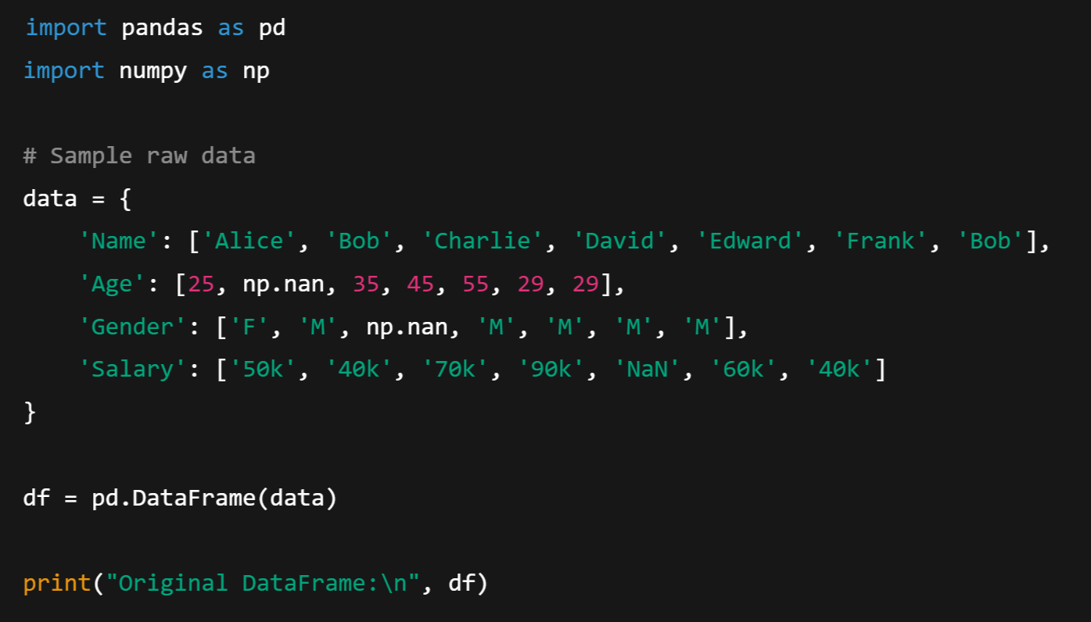
🔧 Example: Data Cleaning & Transformation with pandas:

Slide 80
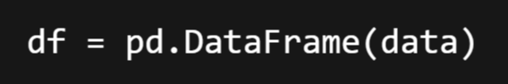
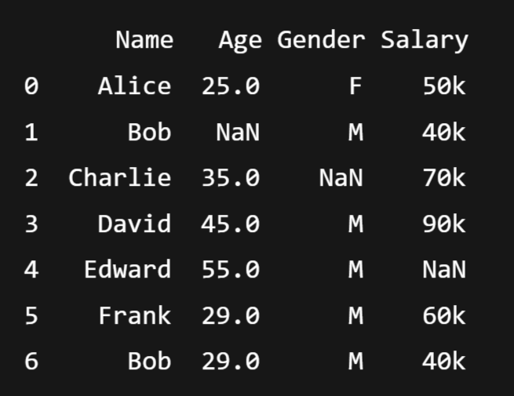
Explanation:
This line creates a DataFrame object from the dictionary data.
📊 Output of df:

Slide 81
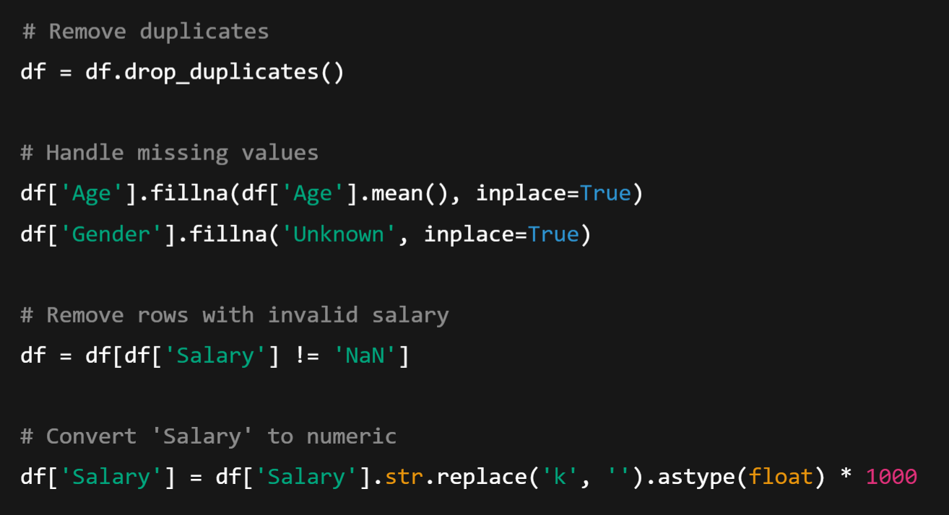
🧹 Step 1: Cleaning

Slide 82
Here,
The parameter inplace=True means that the operation will modify the existing DataFrame directly — without creating a new one.
Convert Salary to numeric:
1. .str.replace('k', ‘’):
Removes the 'k' from the end of salary strings (e.g., '50k' → '50’).
2. .astype(float)
Converts the resulting strings to numeric float values.
3. * 1000
Converts the salary from thousands to actual amounts.
Example: '50k' → 50 → 50000.0

Slide 83
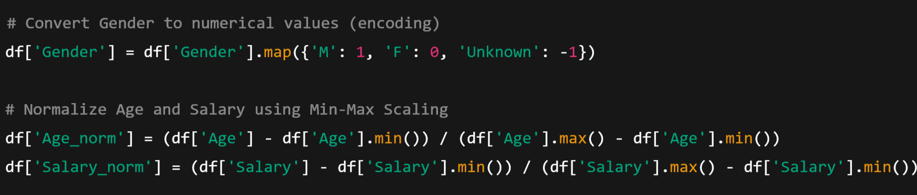
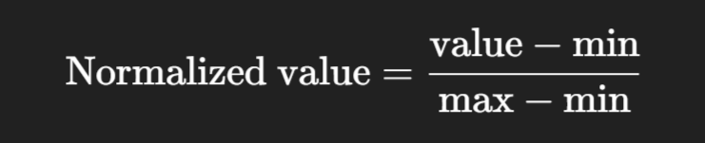
🔄 Step 2: Transformation
Normalization Formula:

Slide 84
What is Normalization
Normalization is the process of scaling numeric data to a standard range, typically between 0 and 1.
🎯 Why Normalize?
To treat all features equally:
In datasets, features (columns) may have very different scales.
Example:
Age might be 18–60
Salary might be 20,000–100,000
Models like KNN, K-Means, Neural Networks are sensitive to such differences.
2. Improves model performance:
Helps models converge faster and perform better.

Slide 85
🔢 Min-Max Normalization Formula:
This scales all values to fall within the [0, 1] range.

Slide 86
✅ Final Cleaned and Transformed DataFrame:
🧾 Final Transformed Table:
Name | Age | Gender | Salary | Age_norm | Salary_norm
Alice | 25.0 | 0 | 50000 | 0.00 | 0.20
Bob | 36.33 | 1 | 40000 | 0.5665 | 0.00
Charlie | 35.0 | -1 | 70000 | 0.50 | 0.60
David | 45.0 | 1 | 90000 | 1.00 | 1.00
Frank | 29.0 | 1 | 60000 | 0.20 | 0.40

Slide 87
Handling missing values and outliers:
🧹 1. Handling Missing Values:
✅ What are missing values?
Missing values occur when data is not available for certain entries in your dataset. In Pandas, they are typically represented as NaN.
Example:
Name | Age | Salary
Alice | 25.0 | 50000
Bob | NaN | 60000
Charlie | 35.0 | NaN
David | 45.0 | 80000

Slide 88
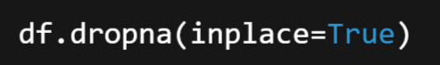
🔧 How to Handle Missing Values
Option 1: Remove rows with missing values
Removes any row that has at least one NaN.

Slide 89
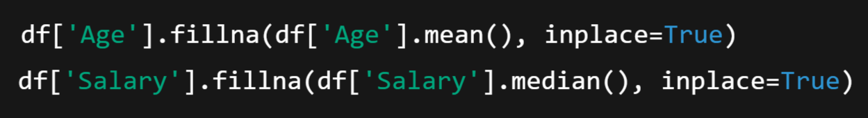
Option 2: Fill missing values with a default (like mean/median)
After filling:
Name | Age | Salary
Alice | 25.0 | 50000
Bob | 35.0 | 60000
Charlie | 35.0 | 60000
David | 45.0 | 80000

Slide 90
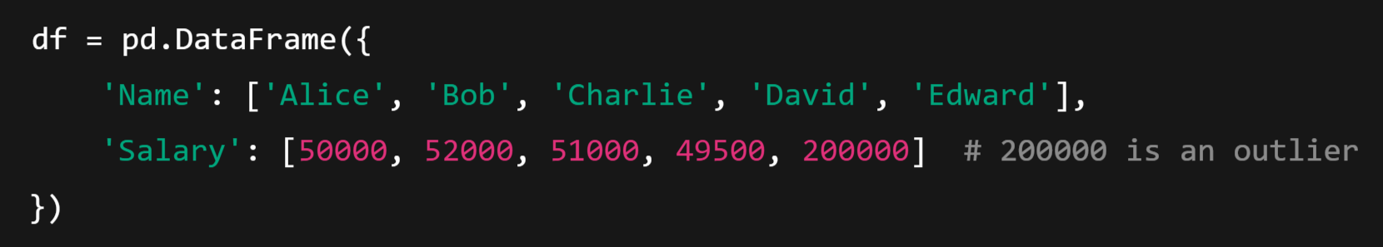
⚠️ 2. Handling Outliers
✅ What are outliers?
Outliers are data points that are extremely high or low compared to the rest of the data. They can distort or misrepresent your analysis and models.
🔍 Example with Outlier

Slide 91
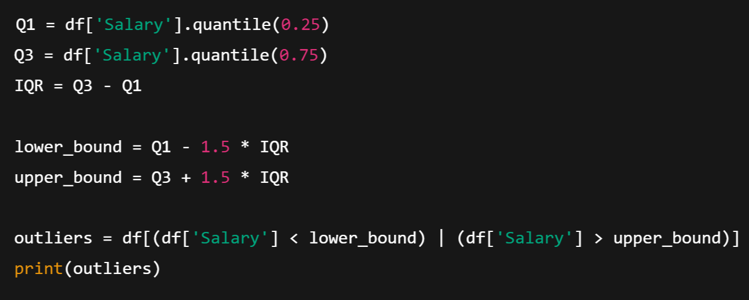
🔎 Detect Outliers (using IQR - Interquartile Range method)

Slide 92
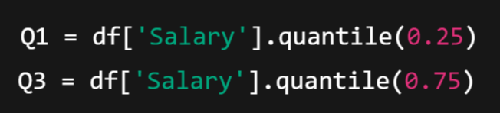
🔍 Step-by-step Explanation:
1️⃣ Calculate Q1 and Q3 (25th and 75th percentiles):
Q1 (1st Quartile): Value below which 25% of the data falls.
Q3 (3rd Quartile): Value below which 75% of the data falls.
📌 Example (based on sorted Salary values):
Sorted Salaries: [49500, 50000, 51000, 52000, 200000]
Q1 = 50000 (25% point)
Q3 = 52000 (75% point)

Slide 93

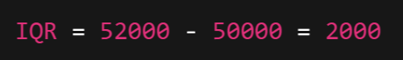
2️⃣ Compute IQR (Interquartile Range):
IQR is the range of the middle 50% of the data.
It tells you how spread out the central values are.
📌 In this example:

Slide 94
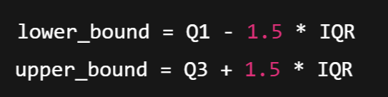
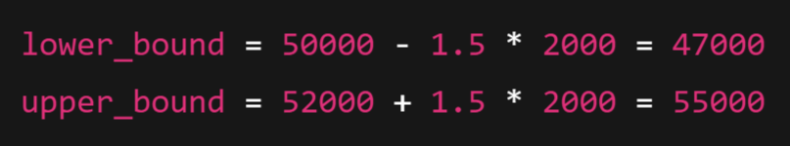
3️⃣ Define lower and upper bounds for outliers:
Any value below lower_bound or above upper_bound is considered an outlier.
This is a standard statistical rule of thumb.
The number 1.5 is a statistical rule of thumb commonly used in box plot analysis to detect mild outliers.
📌 In our example:

Slide 95
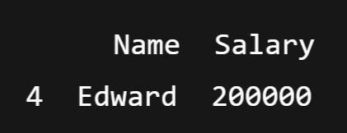
4️⃣ Identify outliers:
This filters rows where the salary is:
less than 47000, or
greater than 55000.
📌 Result:
So Edward is identified as an outlier based on salary.

Slide 96
🔧 How to Handle Outliers
Option 1: Remove outliers
Option 2: Cap or floor outliers:
It checks each element of df['Salary’] :
If the salary is greater than upper_bound, it replaces it with upper_bound.
Otherwise, it keeps the original salary.

Slide 97
Feature scaling and Normalization:
🚀 What is Feature Scaling?
Feature scaling is a technique to bring all input features to the same scale or range.
👉 It's especially important for algorithms that rely on distance (like KNN, SVM, Logistic Regression, Neural Networks).
Two Common Types of Feature Scaling:
Normalization (Min-Max Scaling)
Standardization (Z-score Scaling)

Slide 98
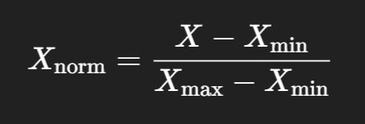

1. Normalization (Min-Max Scaling)
Rescales the data to a range between 0 and 1.
Formula:
2. Standardization (Z-score Scaling):
Rescales the data to have a mean = 0 and standard deviation = 1.
Formula:
Where
μ is the mean
σ is the standard deviation

Slide 99

🧪 Example Dataset

Slide 100
🔄 Normalization (Min-Max Scaling):
👉 Output:
Age | Salary | Age_norm | Salary_norm
25 | 50000 | 0.00 | 0.00
30 | 60000 | 0.17 | 0.17
45 | 80000 | 0.67 | 0.50
50 | 120000 | 1.00 | 1.00
35 | 70000 | 0.33 | 0.33

Slide 101

🔄 Standardization (Z-score Scaling):
👉 Output (approx):
Age | Salary | Age_std | Salary_std
25 | 50000 | -1.41 | -1.18
30 | 60000 | -0.71 | -0.56
45 | 80000 | 0.53 | 0.31
50 | 120000 | 1.24 | 1.86
35 | 70000 | 0.35 | -0.43

Slide 102
Module-1: Introduction to Machine Learning and Python:
Introduction to Machine Learning: Definition and importance of machine learning, Types of machine learning: Supervised, unsupervised, and reinforcement learning, Applications of machine learning in various domains.
Python for Data Analysis: Introduction to Python programming, Python libraries for data analysis: NumPy, Pandas, Matplotlib, Data manipulation and visualization using Pandas and Matplotlib.
Data Preprocessing: Data cleaning and transformation, Handling missing values and outliers, Feature scaling and normalization.

